Slide 1
What even is an urban planner?
Geography 446
CSULB
April 19, 2019

Slide 2
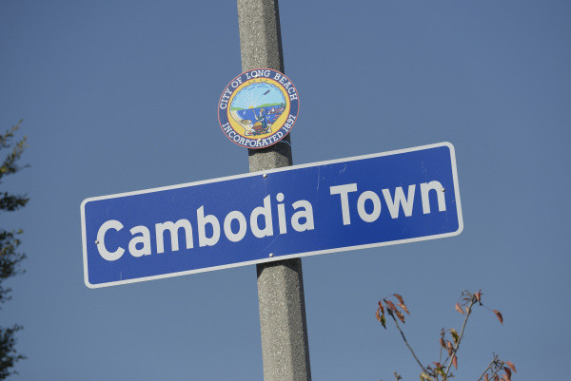
Source: OC Register

Slide 3

Community-controlled land
Our mission is to serve as a steward for community-controlled land; to be a catalyst for values-driven, community-serving development; to build awareness and community leadership in issues of housing, transportation and recreation; and to create programs and initiatives that encourage community building and economic opportunity.

Slide 4
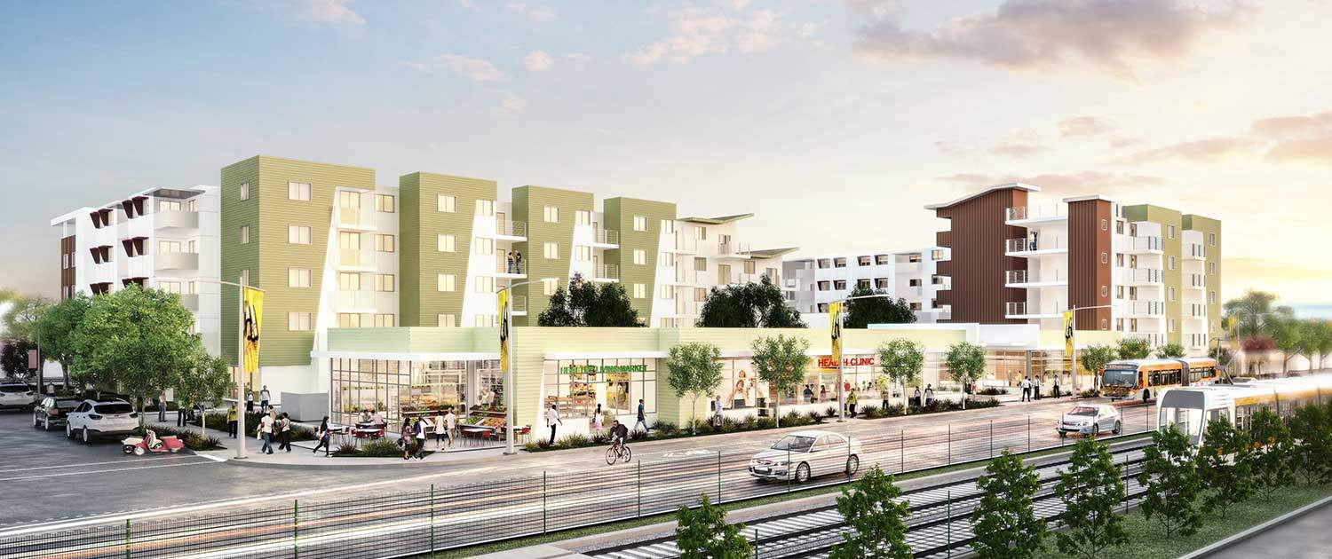
New Construction
Source: Abode Communities

Slide 5
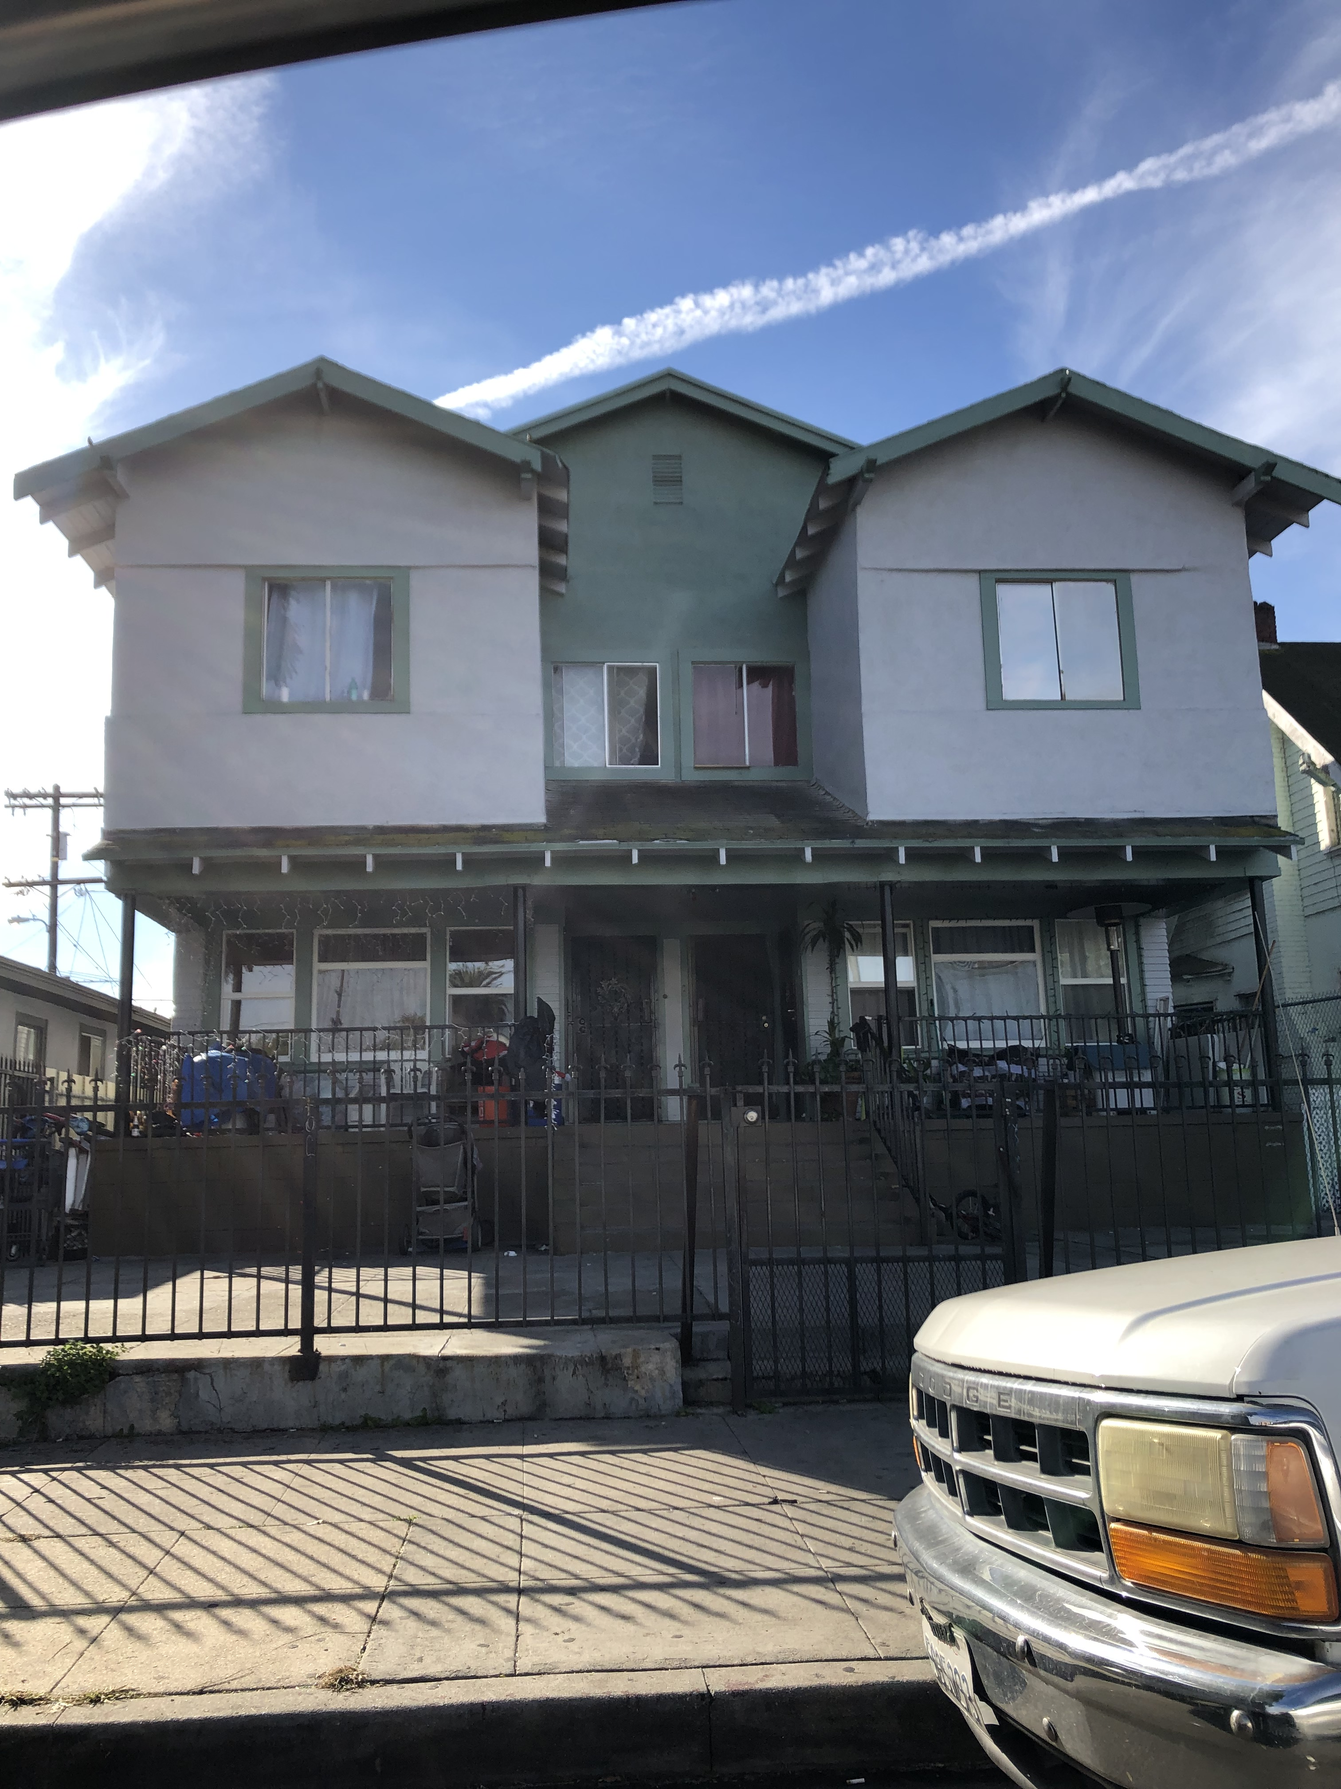
Scattered site rehab

Slide 6
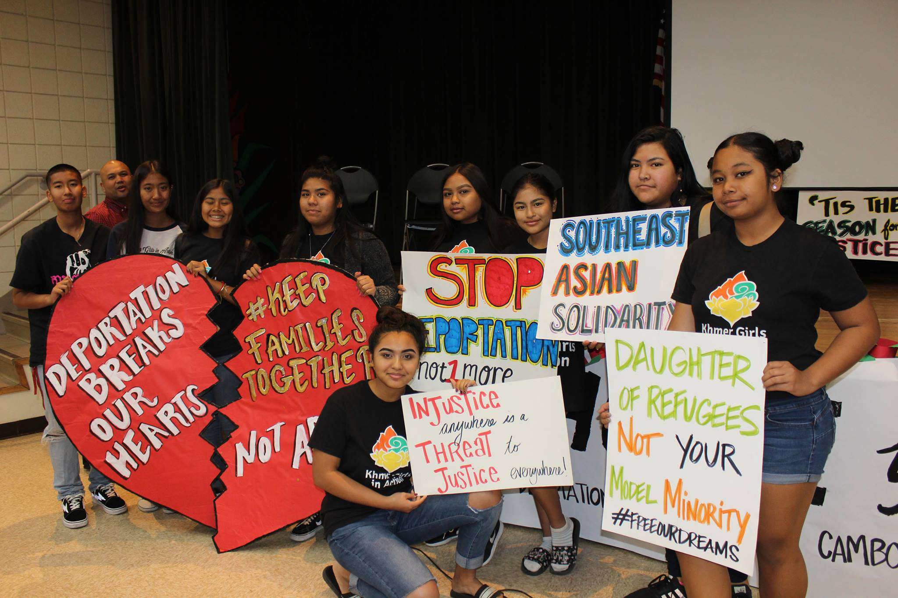

Khmer Girls in Action
Source: Khmer Girls in Action

Slide 7
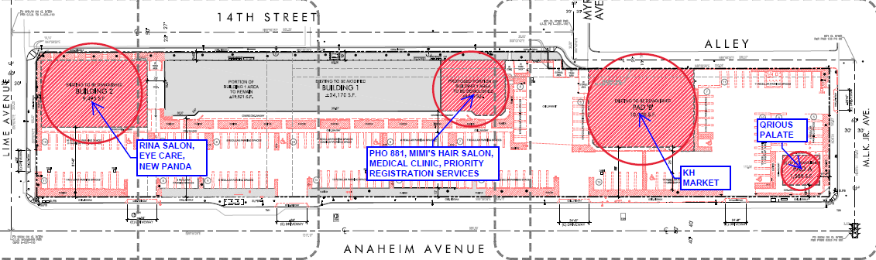
Future of Cambodia Town?
Source: Anaheim Altantic Work Group

Slide 8
Sheila Nem Sy
sheila@kgalb.org
562-986-9415

